Slide 1
Tuesday, September 20, 2016
Write In Your Agenda:
Write In Your Monitoring Log:
CW:
Convergent and Divergent Boundaries PPT and Notes.
HW:
None
Response to Warm-Up:
List one fun fact about sea floor spreading.
You will need:
Pencil

Slide 2
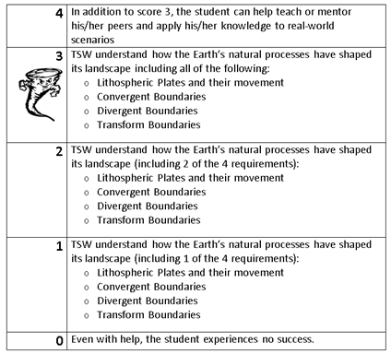
Learning Goal and Scale
TSW understand how the Earth’s natural processes have shaped its landscape (including Lithospheric Plates and their movement, Convergent, Divergent, and Transform boundary landforms).

Slide 3
https://www.youtube.com/watch?v=KCSJNBMOjJs

